Slide 1

Cloud Storage Forensics
Name:- Prajapati Himil
Course Name:- MSc. DFIS Sem II
Enrollment No.:- 01220300003011
Guided by:- DR. NILAY MISTRY
(Associate Professor)
NFSU

Slide 2
ABSTRACT
Cloud storage and Cloud servers, it has become easier than ever to backup all our important computer files online.
Cloud forensics is the practice of collecting and analyzing digital evidence from cloud computing systems in order to investigate and solve criminal cases or security incidents.
This Project Presents the cloud forensic for process and a so more briefly describe about the cloud forensic investigation like stand alone and web-based cloud forensic, and find the evidence from disk image analysis

Slide 3
OBJECTIVE OF THE RESEARCH
The primary motive of this experimental research is to understand and analyze the Cloud
storage client and web application installed on the computer and its interactions with the
server service. This is also to monitor the kind of information that is exchanged or
transmitted in the interactions. Research into some of the ways you can protect your system
from being compromised using your client application sitting on the user's local computer
system. There to understand the technics needed to effectively investigate
The research has to answer the following questions
1. Best Cloud Storage architecture that supports cloud forensic investigation
2. Monitor the interactions between the user system and the remote center
3. Changes made to computers as in cloud storage interactions

Slide 4
Introduction To Cloud Computing
Cloud Computing referred as the accessing and storing of data and provide services related to computing over the internet.
1
It simply referred as it remote services on the internet manage and access data online rather than any local drives.
2
The term "cloud computing" was coined to describe the concept of delivering computing services over the internet
3
The word "cloud" was used as a metaphor for the internet, which is often represented as a cloud in network diagrams.
4

Slide 5
END User
Service Provider
Storage
Server
Computer Network
Service

Slide 6
Cloud Computing Service Providers
Amazon AWS
Microsoft Azure
Google Cloud
IBM Cloud

Slide 7
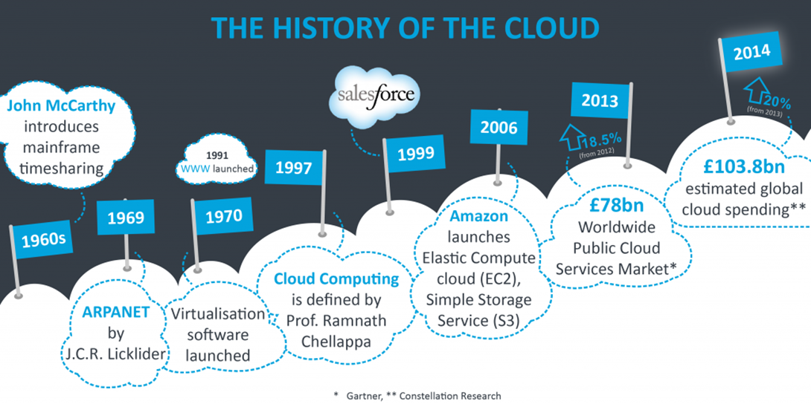

Slide 8
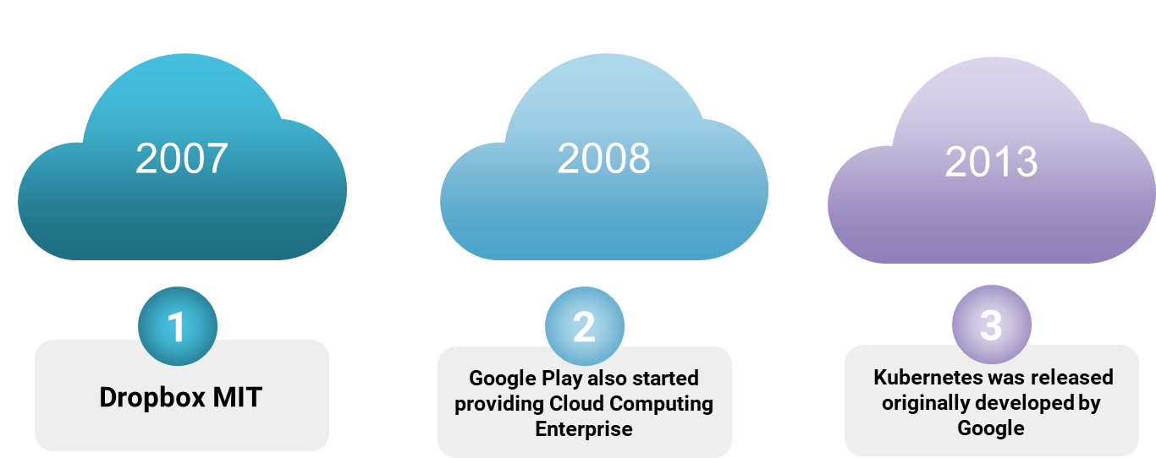

Slide 9
CLOUD ARCHITECTURE
FRONT END
BACK END
40%
The client uses the front end, which contains a client-side interface and application
The front end includes web servers (Chrome, Firefox, Opera, etc.), clients, and mobile devices.
60%
The backend part helps you manage all the resources needed to provide Cloud computing services
This Cloud architecture part includes a security mechanism, a large amount of data storage, servers, virtual machines, traffic control mechanisms, etc..

Slide 10
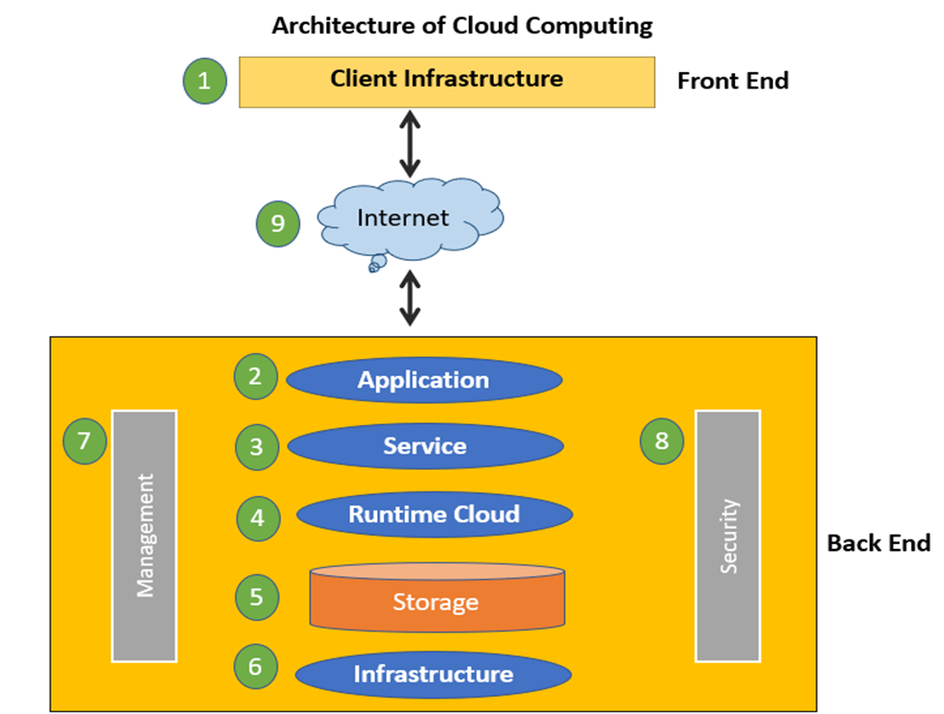

Slide 11
CLOUD ARCHITECTURE
1
Internet connection acts as the bridge or medium between frontend and backend.
Internet
Database
2
Database in backend refers to provide database for storing structured data, such as SQL and NOSQL databases.
3
Networking in backend services that provide networking infrastructure for application in the cloud such as load bal. DNS and VPN
Networking
Analytics
4
Analytics in backend service that provides analytics capabilities for data in the cloud, such as ML., BI, etc

Slide 12
Types of Clouds
cloud service provider owns and runs the business of providing cloud computing resources such as servers, software, storage, hardware all over the internet.
delivered to users via a web browser
The Hybrid cloud model is a merger of the public and private clouds making it possible to share computing resources between the 2 architecture, A good implementation of the hybrid cloud provides higher elasticity to the company.
The infrastructure could be located on the company’s premises or may be outsourced to a third-party business to host on behalf of the organization. This means the service is run on a private network
Public
Private
Hybride

Slide 13
Types of Service
IaaS
The service provider owns the equipment and is responsible for housing, running and maintaining it. The client typically pays on a per-use basis.
PaaS
Saas
A software distribution model in which a third-party provider hosts application and makes them available to customers over the internet
is a way to rent hardware, operating systems, storage and network capacity over the Internet. The service delivery model allows the customer to rent virtualized servers and associated services for running existing applications or developing and testing new ones.

Slide 14
Advantages of using Cloud
Financial
It can be less expensive compared to buying software and hardware
Mobility
Can be used from any computer or device with an Internet connection
Infrastructure
the device does not need as large of an internal storage system
0 Dependence
Compatible with most computers and operating systems
AI/ML
organizations to achieve faster time to market and incorporate AI and ML use cases into their strategies.

Slide 15
Disadvantages
Security Issues
high Cost for Big Data
Dependency on Internet Speed

Slide 16
Challenges of Cloud Forensics
1
2
3
4
Jurisdiction complications:
unavailable or deleted data
Physical access
Decentralization
Cloud services are often hosted in different states or countries
Cloud providers may differ in terms of the information they provide to investigators.
In some cases, physically inspecting a cloud server can help with forensics.
This decentralization and fragmentation make it more challenging to identify the problem and perform forensics

Slide 17
Digital Forensics Investigation on cloud storage services by (HyunjiChung, JungheumPark, SangjinLee, CheulhoonKang) [1] The demand for cloud computing is increasing because of the popularity of digital devices and the wide use of the Internet. Among cloud computing services, most consumers use cloud storage services that provide mass storage. This is because these services give them various additional functions as well as storage. It is easy to access cloud storage services using smartphones. With increasing utilization, it is possible for malicious users to abuse cloud storage services. Therefore, a study on digital forensic investigation of cloud storage services is necessary. Cloud Storage Forensics by (Darren Quick, Ben Martini, Raymond Choo) [2] Cloud Storage Forensics presents the first evidence-based cloud forensic framework. By determining the data remnants on client devices, you gain a better understanding of the types of terrestrial artifacts that are likely to remain at the Identification stage of an investigation. Once it is determined that a cloud storage service account has potential evidence of relevance to an investigation, you can communicate this to legal liaison points within service providers to enable them to respond and secure evidence in a timely manner. Context of these paper is to conduct a forensic analysis of cloud client storage on a Windows 7 virtual machine. To find all the possible traces left on the system that uses the cloud storage application and try to find the traces even after the application is deleted from the system.
LITERATURE REVIEW

Slide 18
Cloud Storage Client Forensic: Analysis of MEGA Cloud by
(Vikas Sihag, Himanshu Mishra's, Gaurav Choudhary, Nicola Dragoni) [3]
This investigative study focused on analyzing forensic artifacts related to the usage of the MEGA cloud storage service across different platforms (Google Chrome browser, Windows application, and Android application). The study successfully recovered various artifacts such as account name, email address, network information, username, and MD5 hash verification of original and downloaded files. Changes in metadata timestamps were observed, and client credentials were recovered. Although the user password could not be located in memory dump or storage
Cloud forensics: Technical challenges, solutions and comparative analysis by
(Ameer Pichan, Mihai Lazarescu, Sie Teng Soh) [4]
This paper addresses the concerns surrounding the security, privacy, and potential misuse of cloud computing services. With the increasing adoption of cloud technology, there is a need to understand and mitigate the risks associated with cybercrimes facilitated by cloud platforms. The paper presents a systematic analysis of the challenges faced in cloud forensics and proposes solutions for each phase of the forensic process. It highlights the maturity of existing solutions while identifying opportunities for further research and development. Additionally, a summary of forensics-as-a-service models is provided as a potential approach to address forensic difficulties in cloud environments.

Slide 19
Forensic Analysis of Google Drive on Windows by
(Ming Sang Chan) [5]
When we investigate the using of cloud storage, the initial stages include the identification of a cloud service and user account. This may enable investigators to identify the location of data. In this research, we find that an investigator can identify Google Drive account use by undertaking keyword searches and examine test files locations to locate relevant information. The remnants of cloud activity can be found on local machines. It could be valuable for the forensic examiners. We found the remnants in local folders. The username, the cache files, and log activity which helps in recovering the deleted files and data. We identify the locations of data and files to determine user details and cloud storage information relating to use of Google Drive in our research

Slide 20
PROCEDURE FOR DIGITAl INVESTIGATION OF CLOUD STORAGE SERVICE
Reporting
Identification
Analysis
Preservation
Collections

Slide 21
ARTIFACTS OF CLOUD STORAGE FORENSIC
Registry
log files
DB
Caches
Most cloud storage services provide client applications for convenience.
These database files contain information about synchronized folders and files on a PC.
names of folders and files, their creation times, last modified times, and whether files were deleted
A personal computer keeps records by logs every attempt to a cloud storage service whether successful or not. It also logs all activities and file operations conducted

Slide 22
METHODOLOGY There are two activities to conduct analysis on 1.Browser 2.Client App
PCloud
1
OneDrive
2
GDrive
3
Mega
4

Slide 23
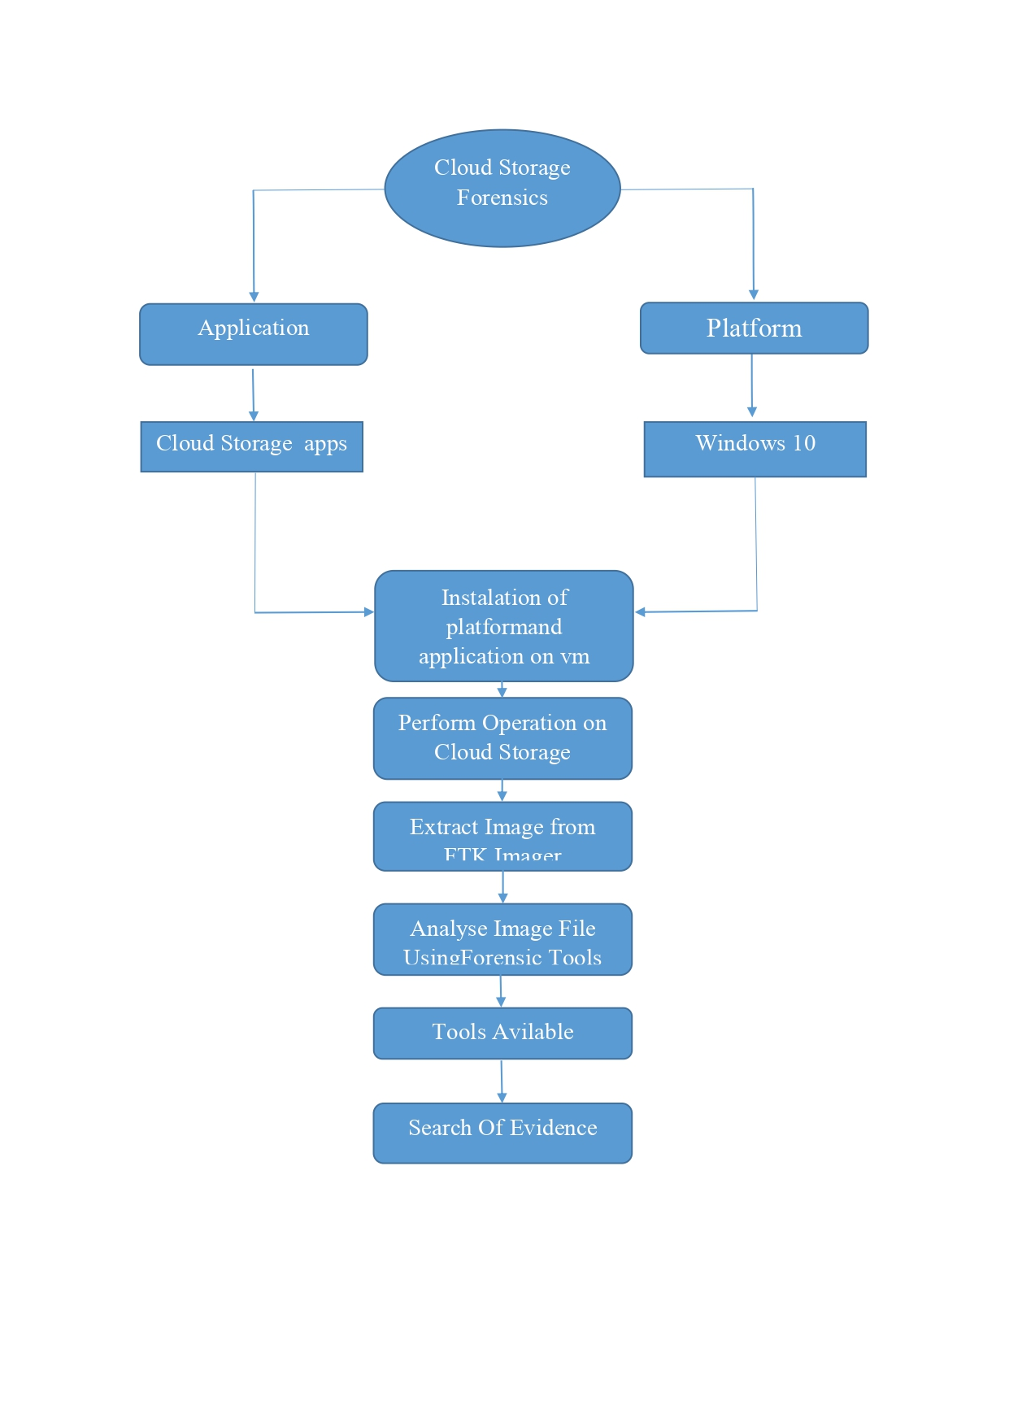
Flow of Work

Slide 24
Tools
VMWARE
FTK Imager
Autopsy
VM ware 17 pro host the machine
Create image & RAM Dump
Analysic disk & artifact & find evdince
Hex Editor
Wireshark
Hindsight
Analysic RAM Dump
Analysic Network Traffic
Live browser Artifact

Slide 25
Pcloud Services
DISK
Crypto
Create logical Disk
Persnal crypto folder (Private space)
Revision
Chrom EXT
take a file in old version
Chrom extantion for save the image and video to direct Pcloud

Slide 26
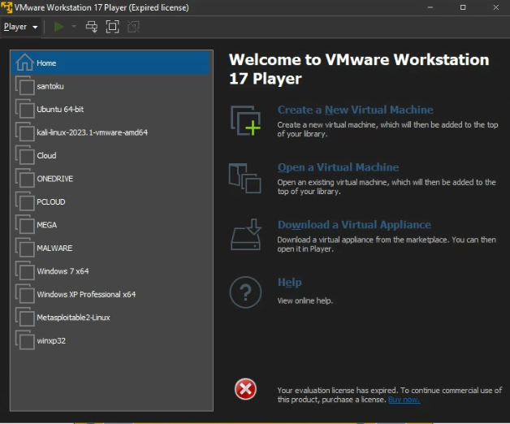
Installation of all the cloud in VM

Slide 27
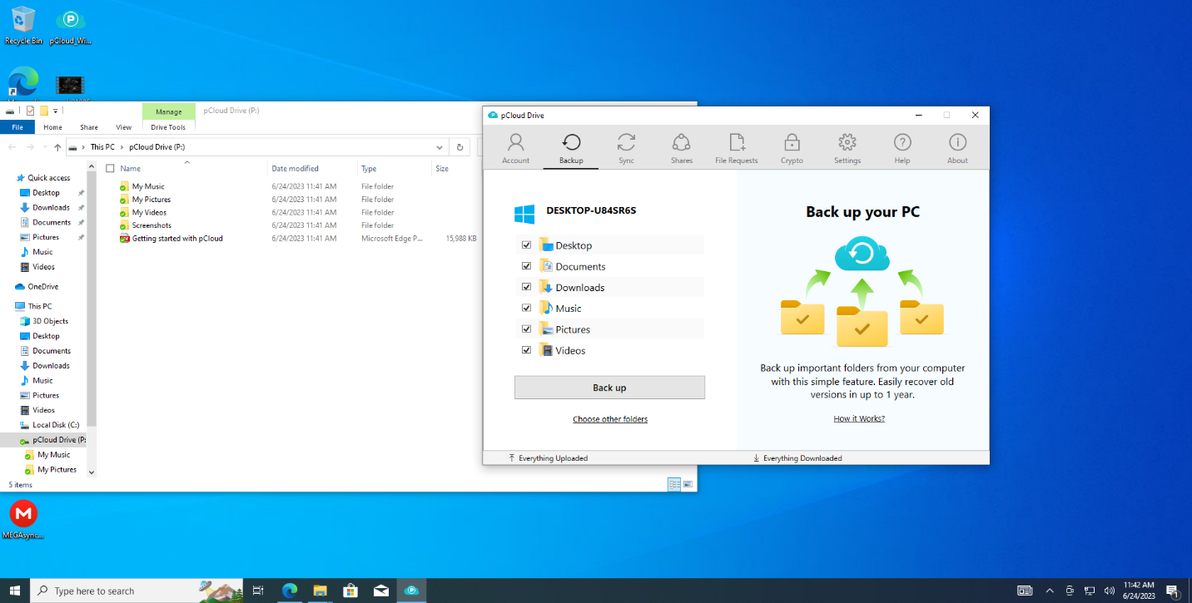
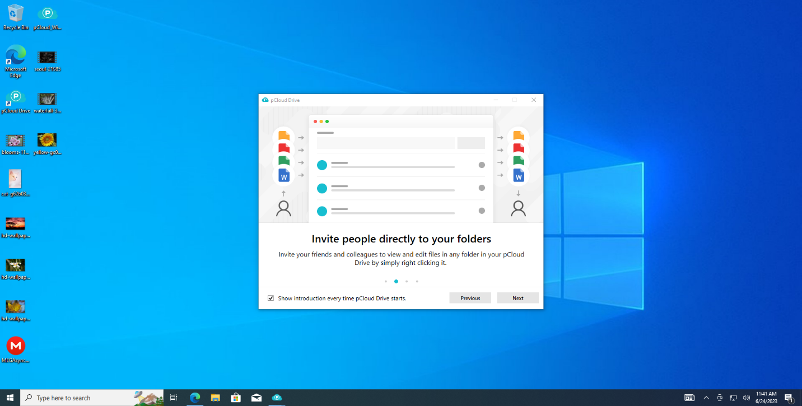

Slide 28
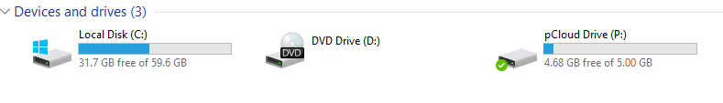
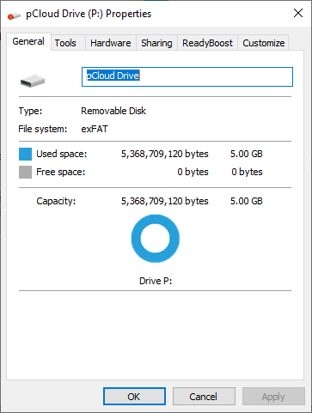

Slide 29
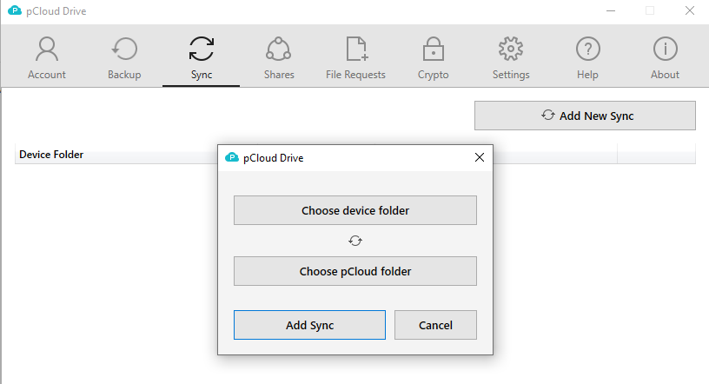
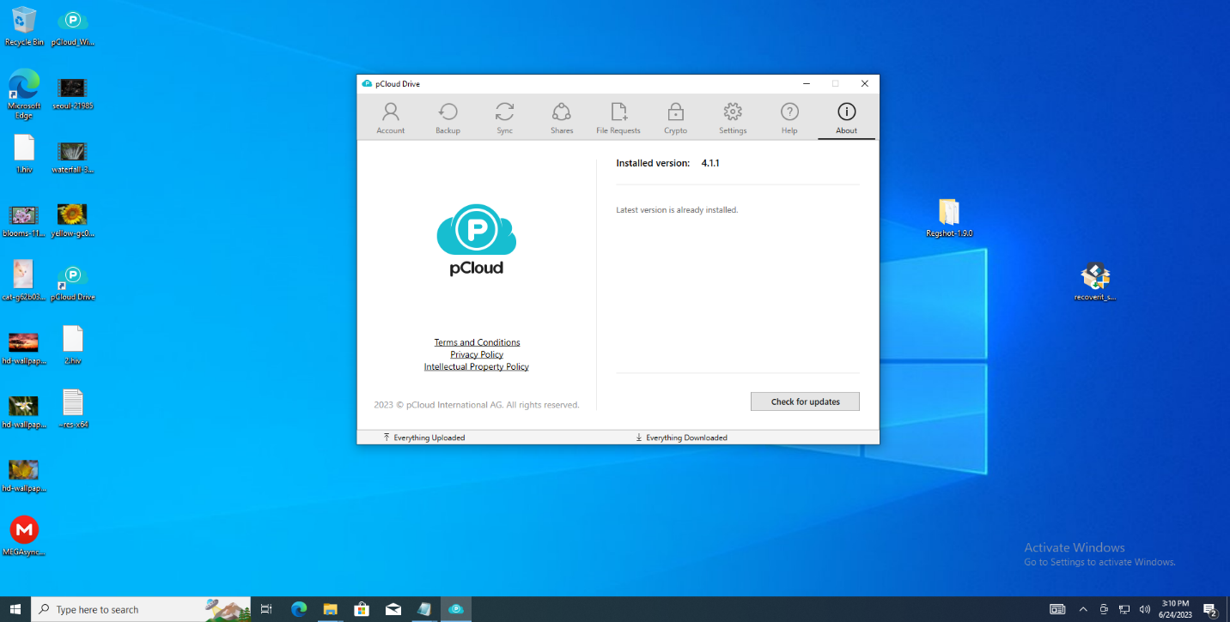
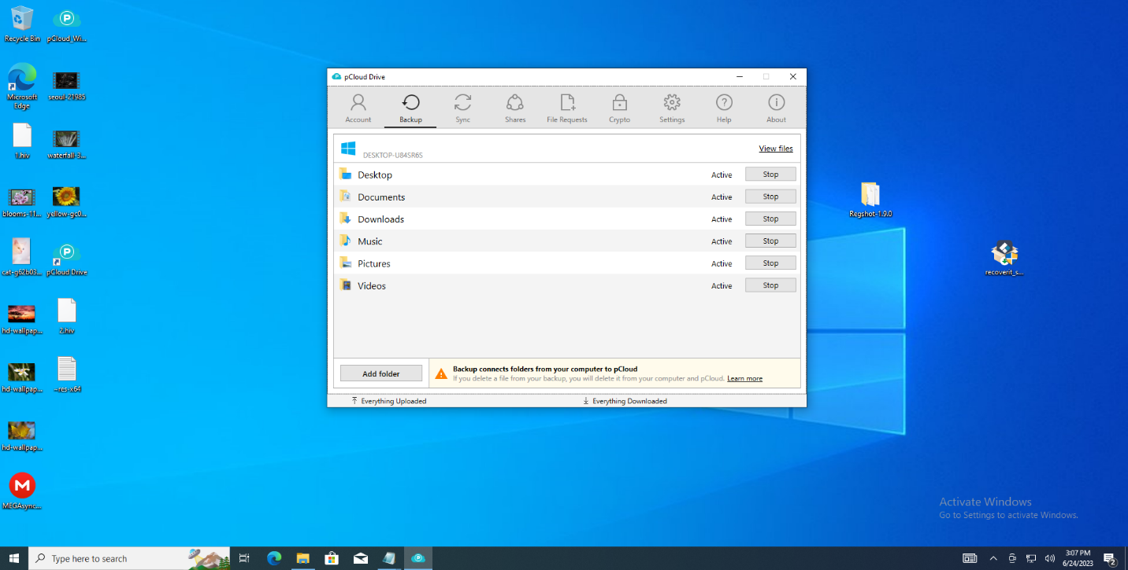


Slide 30
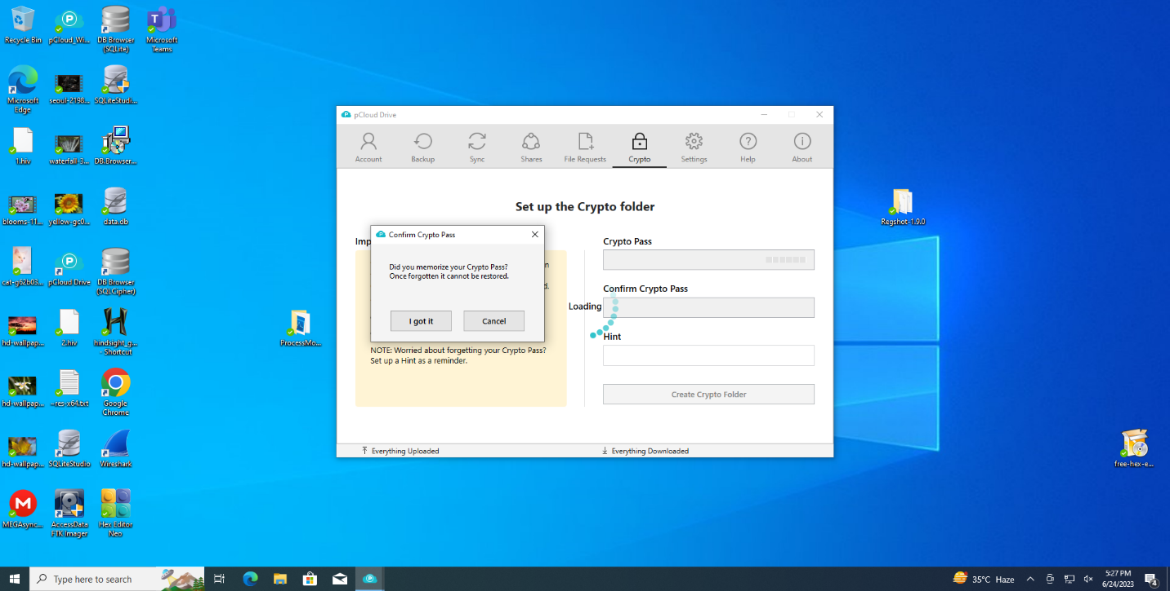
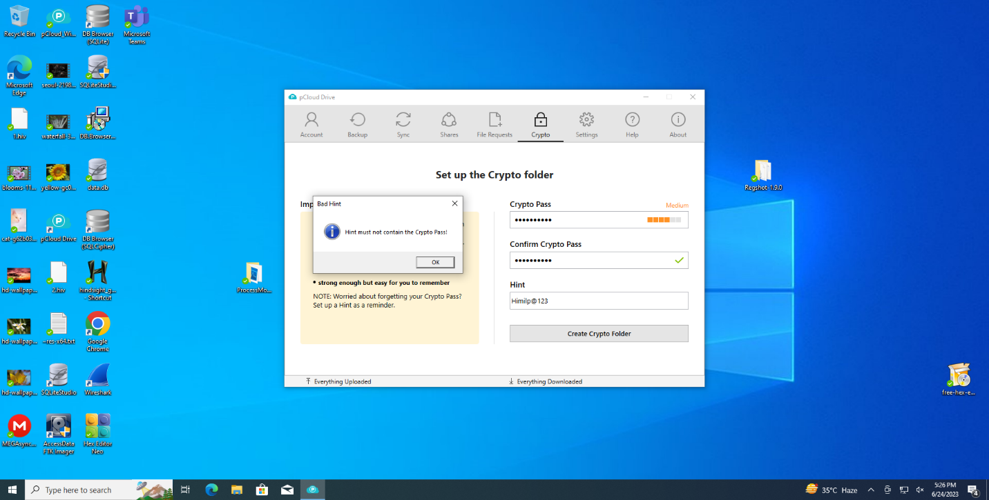
Password include Upper and lower case char. Special char. Numeric after also it will show a Medium level password
If the password is forgot than no recovery is there for the free user valid only for 15 days

Slide 31
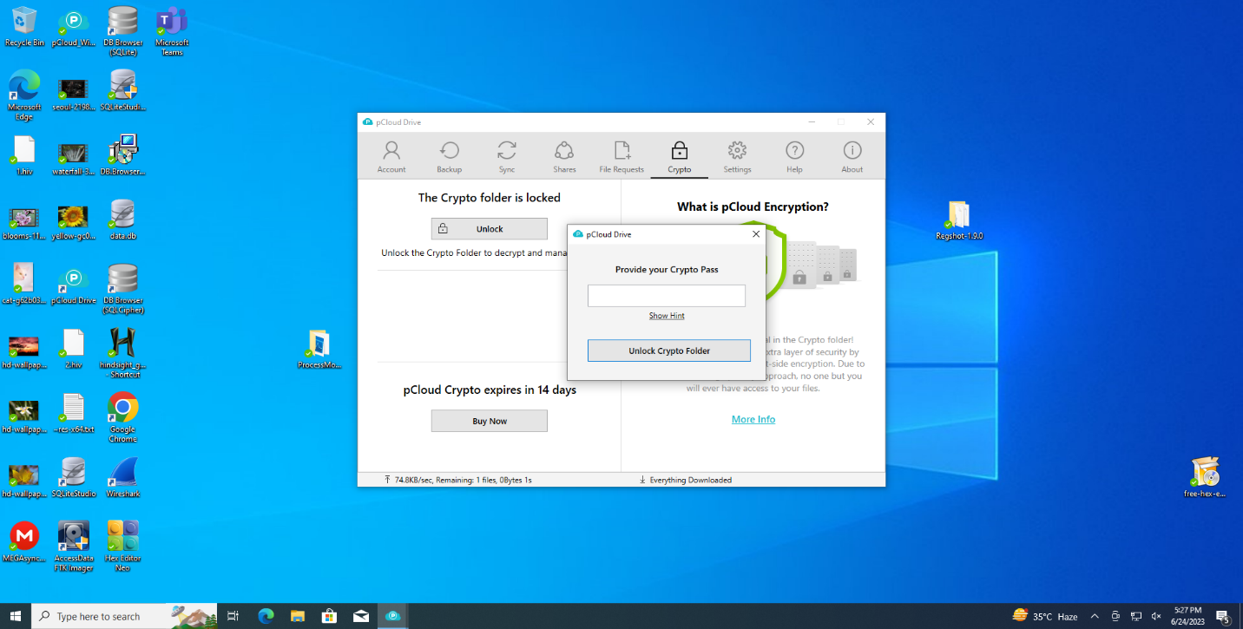
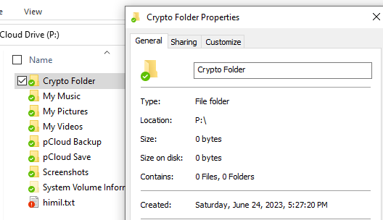
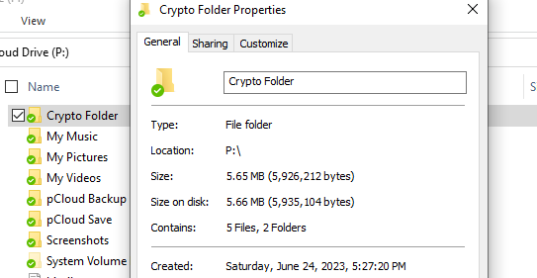

Slide 32
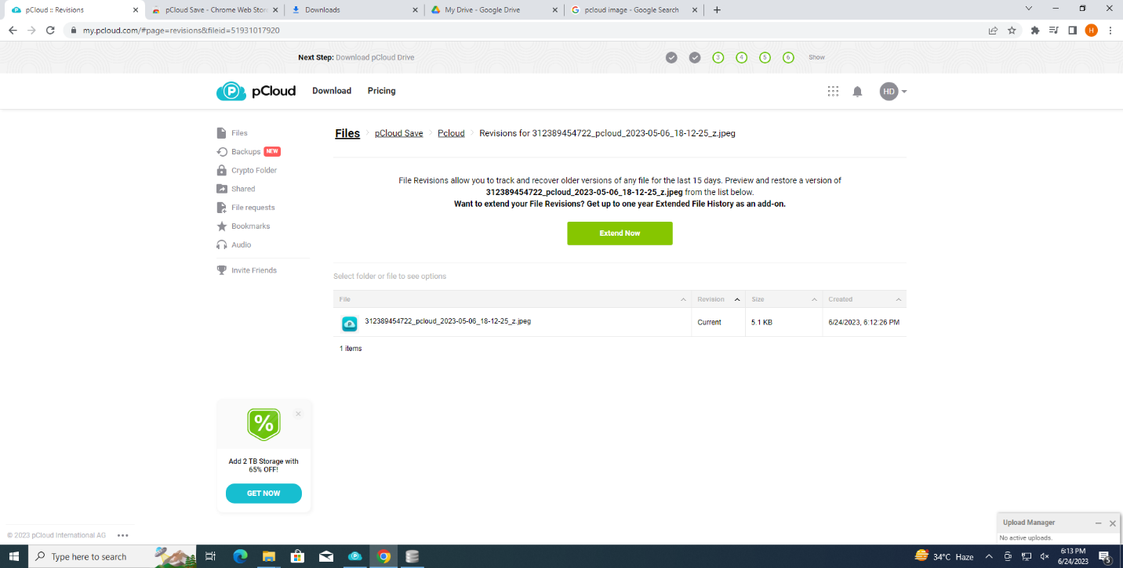
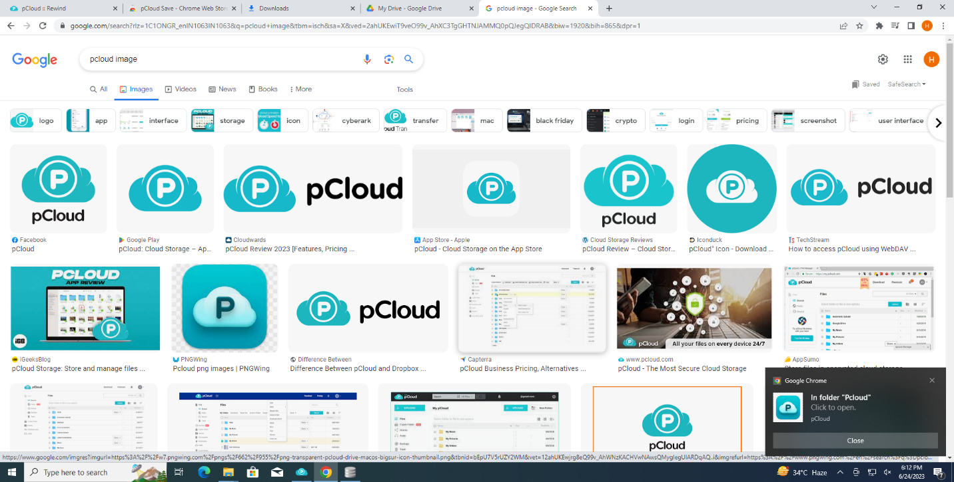
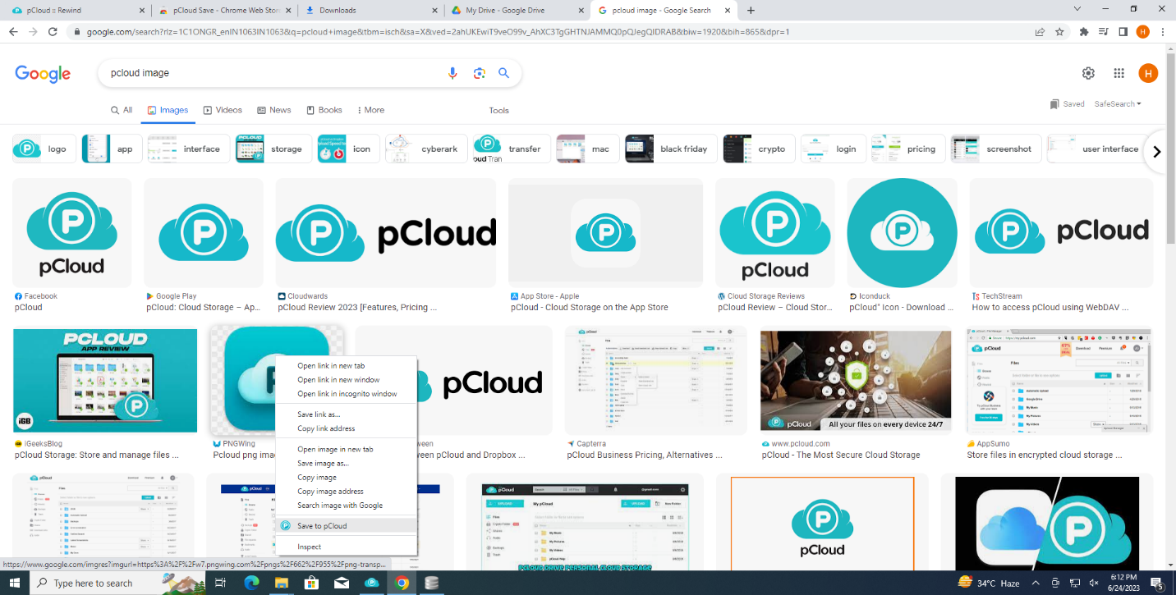
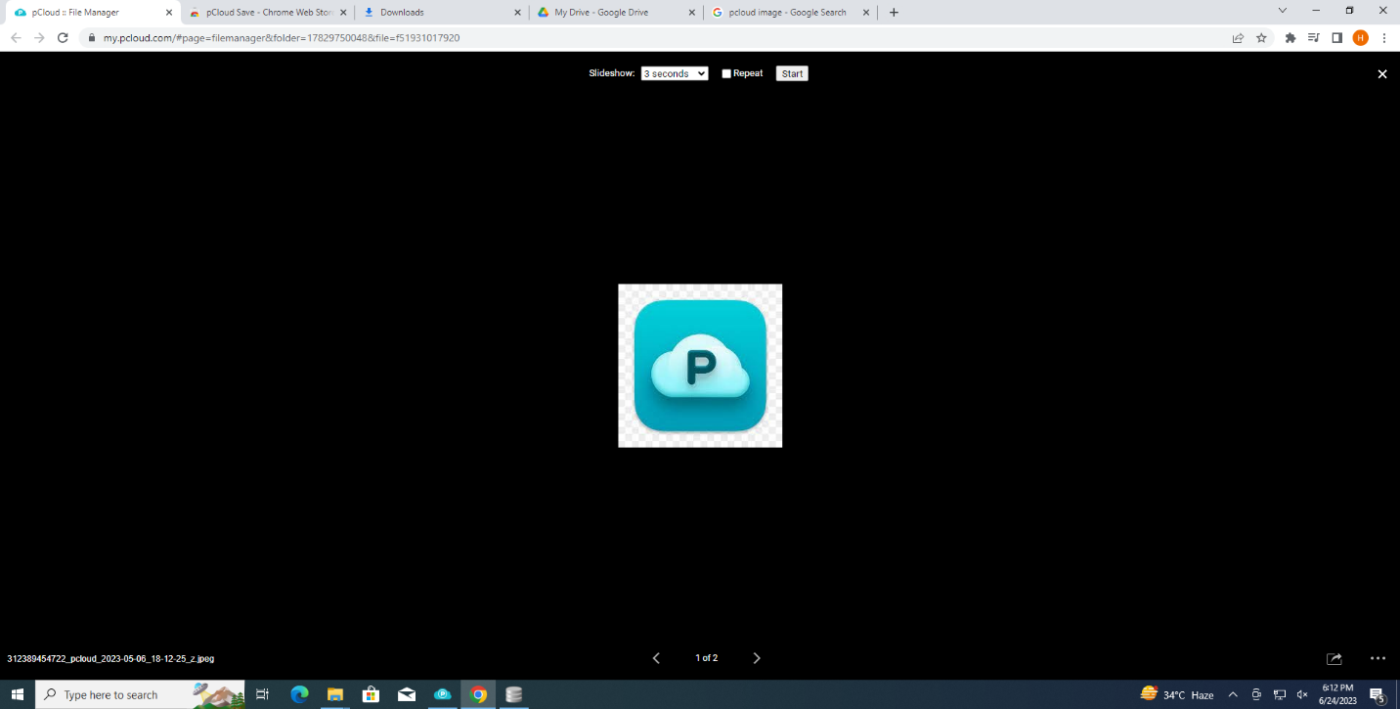

Slide 33
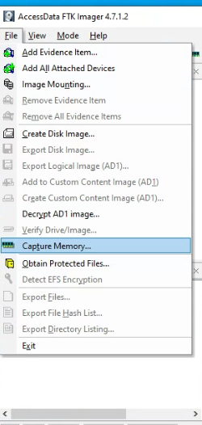
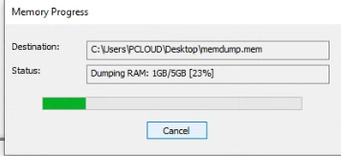
Ram Dump created by FTK imager

Slide 34
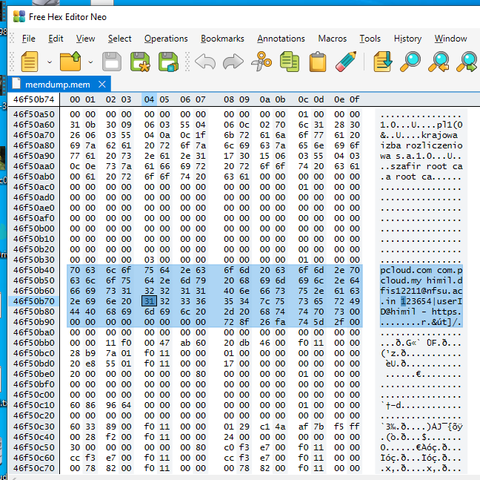
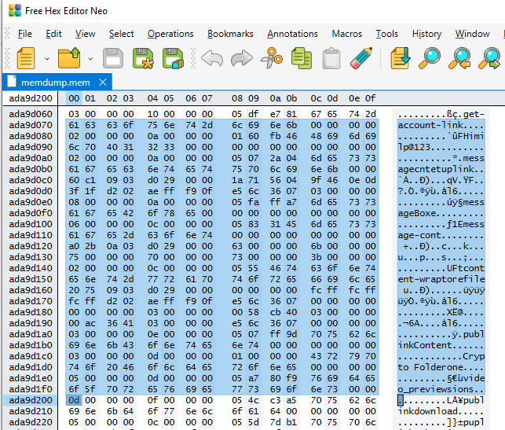
FTK image create Ram Dump open in Hex editor

Slide 35
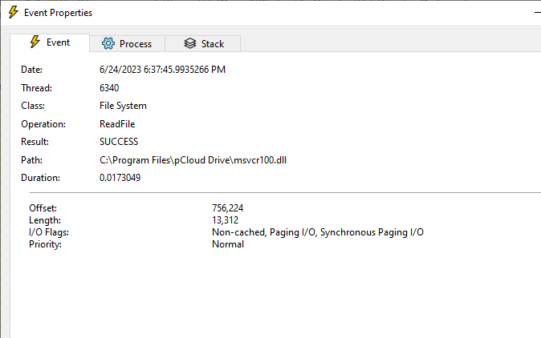
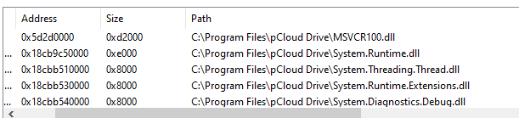
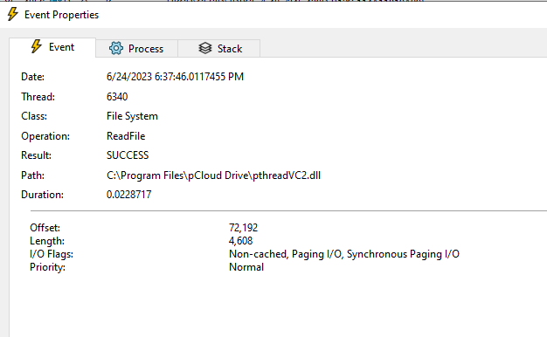
.DLL used by the pcloud this finding is done by the process monitor

Slide 36
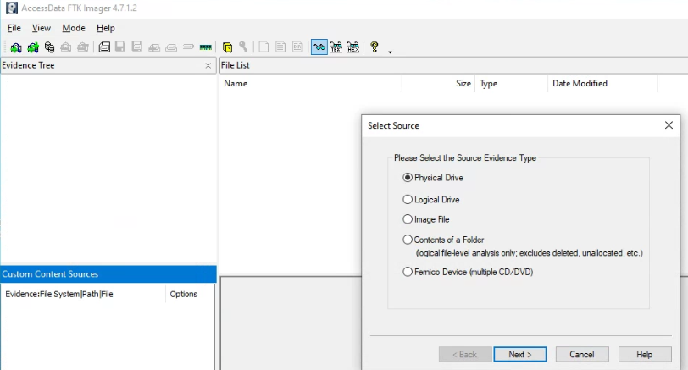
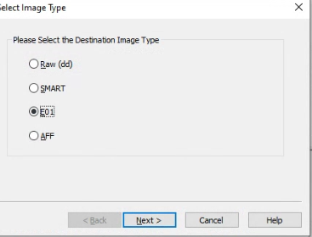
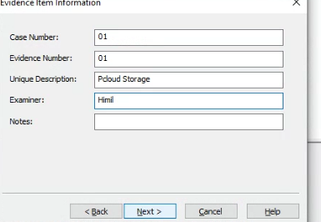

Slide 37
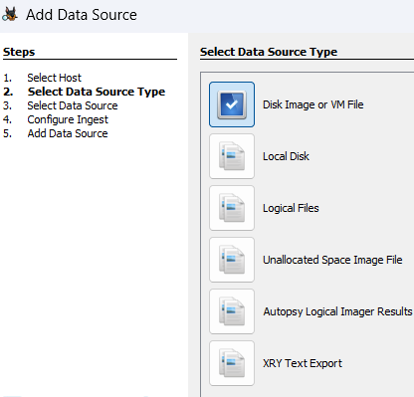
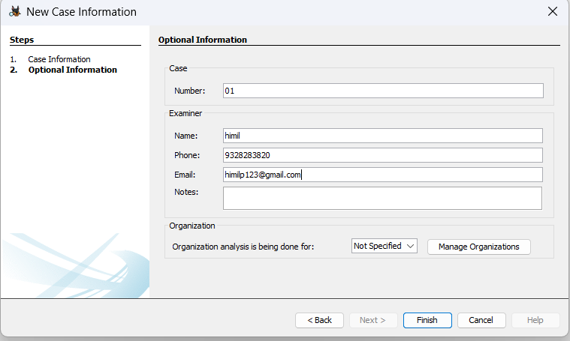
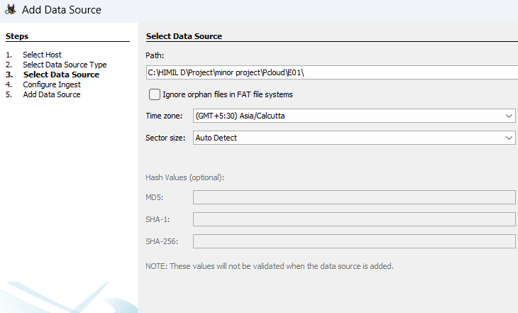
Open the E01 file in autopsy

Slide 38
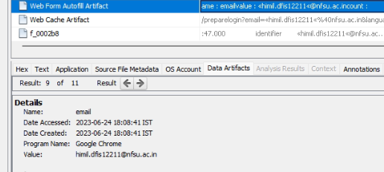
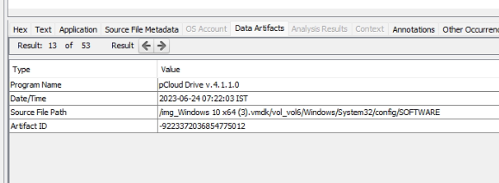
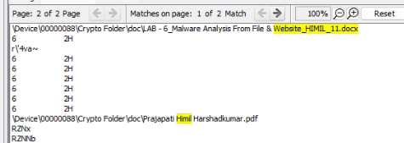
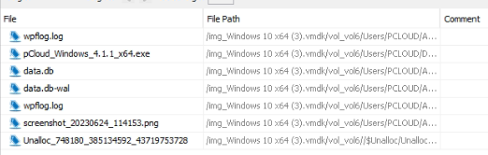

Slide 39
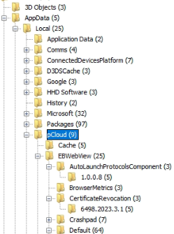
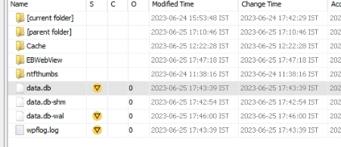
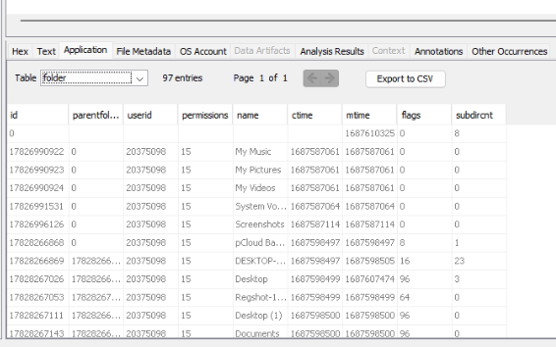
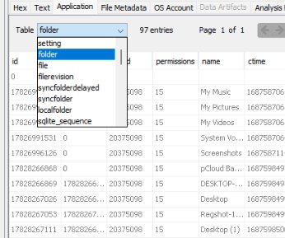

Slide 40
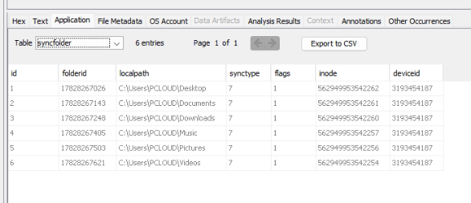
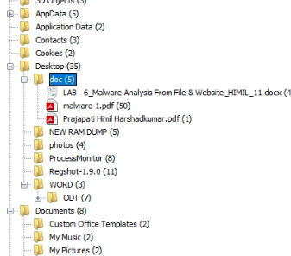
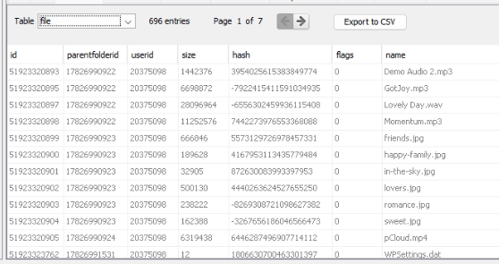

Slide 41
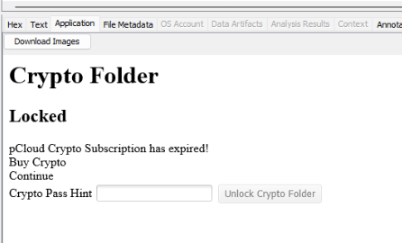
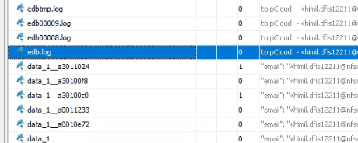
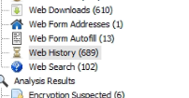
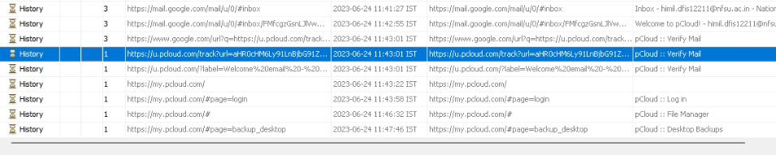

Slide 42
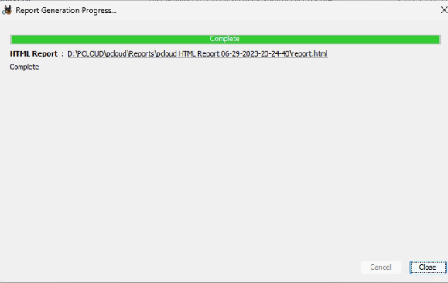

Slide 43





Slide 44
Pcloud Finding
10%
35%
5%
Deleted files
RAM Dump
History
Network
Deleted file in the autopsy
Browser History ID
Cookies & session ID
Used the secured network TLSV2
Pcloud user ID & Password & Crypto Password
Sync time file location
50%

Slide 45
MEGA Cloud Services
Effect on PC Delete from cloud and on PC
at same
Free Lage storage no Cloud can give a20GB Storage at free level
No Trace From the Ram Dump no Trace

Slide 46




Installation

Slide 47





Slide 48



Ram Dump Network check

Slide 49




Slide 50






Mega image opened in Autopsy

Slide 51







Slide 52



Slide 53
MegaFinding
10%
35%
5%
Deleted files
RAM Dump
History
Network
Deleted file in the autopsy
Browser History ID
Cookies & session ID
Used the secured network TLSV1.2
MEGA user ID & Sync time file location
50%

Slide 54
One Drive
Vault
Deafult
One drive gives a Vault feature to save the data private in Drive
It will installed in windows not install
Limated
Securety
One drive provied a 5 GB space only
Password leak

Slide 55





Slide 56




Slide 57




Slide 58




One drive not give a file in the normal form it will give in .lnk so that we can`t open in so we can check in another trace of that file on pc

Slide 59





Slide 60





Slide 61





Slide 62





Slide 63





Slide 64
One drive Finding
10%
35%
5%
Deleted files
RAM Dump
History
Network
Deleted file in the autopsy
Browser History ID
Cookies & session ID
Used the secured network TLSV1.2
MEGA user ID & Sync time file location
50%

Slide 65
Google Drive
Other Application
Bydeafult it will install all other application like side,docs and sheets
Medium Storage
Google drive
It will give 15 GB free space
Disk
Google create a logical disk in pc

Slide 66




HKLM/SOFTWARE/Google/DriveFS/Driver Version: "3.1092.2150.0" HKLM/SOFTWARE/Google/DriveFS/LastUpdateTime: 0x645A362D

Slide 67


Slide 68



Google drive install the other apps like sheets, docs and slide

Slide 69




Slide 70




Ram Dump by task manager

Slide 71


User name and Password are came out by ram dump

Slide 72



In autopsy we can get gdrive.exe installed and folder of drive

Slide 73





Slide 74





Slide 75






Slide 76

Live browser Artifact

Slide 77
Details | Ram Dump |  |  | Disk Analysis |  |  | Networking
 | Email ID | Password | Internal Store password | DB | Sync Plain files | Browse ring history | Secured network TLSV2
Pcloud | ✓ | ✓ | × | ✓ | ✓ | ✓ | ✓
Mega | ✓ | × | - | ✓ | ✓ | ✓ | ✓
GDrive | ✓ | ✓ | - | ✓ | ✓ | ✓ | ✓
OneDrive | ✓ | × | × | ✓ | × | ✓ | ✓

Slide 78
Future Scopes
We can expand the forensics From Windows Environment to the other Environment like Android, IOS
We can expand this work to the direction of smart phone forensics.
As the Cloud services are evolving day by day we can expand our works for other service provider as well like Drop Box, amazon, azure
Develop Script Which Can Extract Drives Data from the Android mobiles and tablets without root permission.
Find Out Database File of Drives
We can make python script that will help us to find the details about deleted files using the log generated by the Drives
Research different decrypt algorithm to decrypt the database.

Slide 79
Thank you

Slide 85
PROBLEM STATEMENT
Cloud computing uptake has become widespread among individuals and organizations.This
has come with security challenges as to the safety of the information stored at these data
centers spread across the global in terms of public cloud services.
There has been may case of compromise organization data stored in cloud storage server
with some having consequences on the affected organizations.
There is a record of several reports of attacks on cloud computing service being used to
distribute malware and viruses, lunching Dos attacks targeting at compromising the data
stored on the server or making them inaccessible.
Cybercrime investigation related to cloud services has been top on discussions due to the
Challenges in the acquisition for artifacts especially those residing in the "cloud".
An investigator requires credentials to be able to access the artifacts store in cloud service
data centers associated with the customer under investigation. This research will concentrate
on an analysis of the cloud storage client applications installed on the computers and the
mode of interaction with the cloud storage service.

Slide 87
Gradient Clouds Infographics
It’s the smallest planet in the Solar System
1
It’s composed of hydrogen and helium
2
Venus has a very poisonous atmosphere
3
It’s the biggest planet in the Solar System
4

Slide 88
Gradient Clouds Infographics
It’s the biggest planet in the Solar System
It’s the smallest planet in the Solar System
Venus has a very poisonous atmosphere
Jupiter
Mercury
Venus

Slide 89
Gradient Clouds Infographics
1
Jupiter is a gas giant and also the biggest planet in the Solar System
1
2
2
Saturn is a gas giant, composed mostly of hydrogen and helium
3
It has a beautiful name and is the second planet from the Sun
3
4
4
Neptune is the fourth-largest planet by diameter in the Solar System

Slide 90
Gradient Clouds Infographics
It’s the smallest planet in the Solar System
1
It’s composed of hydrogen and helium
2
Venus has a very poisonous atmosphere
3
It’s the biggest planet in the Solar System
4

Slide 91
Gradient Clouds Infographics
Mercury
Mercury is the closest planet to the Sun and the smallest one
Jupiter
It’s a gas giant and the biggest planet in the Solar System
Saturn
Yes, this is the ringed one. It’s composed of hydrogen and helium
Mars
Despite being red, Mars is a cold place. It’s full of iron oxide dust
Venus
Venus has a beautiful name and is the second planet from the Sun

Slide 92
Gradient Clouds Infographics
Despite being red, Mars is a cold place. It’s full of iron oxide dust, which gives this beautiful planet its reddish cast
Jupiter is a gas giant and the biggest planet in our Solar System—it’s only a bit larger than the Moon. It’s the fourth-brightest object in the sky
Venus has a beautiful name and is the second planet from the Sun. It’s terribly hot, and its atmosphere is extremely poisonous

Slide 93
Gradient Clouds Infographics
10%
35%
5%
Jupiter
Mercury
Venus
Neptune
Jupiter is the biggest planet of them all
Mercury is the closest planet
to the Sun
Venus is the second planet from the Sun
Neptune is the farthest planet from the Sun
50%

Slide 94
Gradient Clouds Infographics
Jupiter
Mars
It’s the biggest planet of them all
Despite being red, it is a cold place
Neptune
Mercury
It’s the farthest planet from the Sun
It’s the closest planet to the Sun

Slide 95
Gradient Clouds Infographics
Jupiter
Mars
It’s the biggest
planet in the Solar System
Mars is a planet full of iron and oxide dust
Venus
Neptune
It has a beautiful name, but it’s terribly hot
Neptune is the
farthest planet
from the Sun

Slide 96
Gradient Clouds Infographics
Mercury is the smallest planet in the Solar System
25%
Jupiter is the biggest planet in the Solar System
15%
Saturn is composed mostly of hydrogen and helium
10%
20%
Mars is a cold place. It’s full of iron oxide dust
Venus has a beautiful name, but it is terribly hot
20%
10%
Neptune is the farthest planet in the Solar System

Slide 97
Gradient Clouds Infographics
Mercury is the closest planet to the Sun
Venus is the hottest planet of them all
Neptune is the farthest planet from the Sun
Jupiter is the biggest planet of them all
Earth is the planet where we live on
Despite being red, Mars is a cold place

Slide 98
Gradient Clouds Infographics
Mercury
Saturn
Venus
Mercury is the closest planet to the Sun
Saturn is a gas giant and has several rings
Venus has a beautiful name, but it’s hot
Jupiter
Mars
Neptune
Jupiter is the biggest planet of them all
Mars is a cold place. It’s full of iron oxide dust
Neptune is the farthest planet from the Sun

Slide 99
Gradient Clouds Infographics
Jupiter Jupiter is a gas giant and the biggest planet in the Solar System
Saturn Saturn is a gas giant composed mostly of hydrogen and helium
Venus Venus is terribly hot and is the second planet from the Sun

Slide 100
Gradient Clouds Infographics
Mars
Despite being red, Mars is a very cold place
Jupiter
Jupiter is the biggest planet of them all
Neptune
Mind Map
Neptune is the farthest planet from the Sun
Mercury
Mercury is the closest planet to the Sun
Venus
Venus is the second planet from the Sun

Slide 101
Gradient Clouds Infographics
1
Saturn is composed of hydrogen and helium
2
Mercury is the closest planet to the Sun
3
Despite being red, Mars is actually a cold place
Process
4
Jupiter is the biggest planet in the Solar System
5
Venus is the second planet from the Sun
6
It’s a gas giant and the most beautiful planet
7
It’s the hottest planet in the Solar System
8
It’s beautiful too, and it’s the ringed one

Slide 102
Gradient Clouds Infographics
Jupiter
Mercury
Mars
It’s composed mostly of hydrogen and helium and it’s the ringed one
Mercury is the closest planet to the Sun and the smallest of them all
Despite being red, Mars is a cold place. It’s full of iron oxide dust

Slide 103
Gradient Clouds Infographics
1
2
3
4
It’s the cutest and smallest planet in
the Solar System
It’s a gas giant. It’s composed mostly of
hydrogen and helium
Venus is the second planet from the Sun. It’s terribly hot
Jupiter is the biggest planet in the entire Solar System

Slide 104
Gradient Clouds Infographics
Mercury
Mars
Saturn
Venus
Mercury is the closest planet to the Sun
Mars is red, but it is actually a cold place
Saturn is the
ringed one and a gas giant
Venus is the second planet from the Sun
Earth
Ceres
Jupiter
Neptune
Earth is the planet where we live on
Ceres is located in the main asteroid belt
Jupiter is the biggest planet of them all
Neptune is the farthest planet from the Sun

Slide 105
Gradient Clouds Infographics
Venus
Venus has a beautiful name, but it’s the hottest and the second planet from the Sun
Jupiter
The planets
Jupiter is a gas giant and also the biggest planet in the entire Solar System
Saturn
Saturn is a gas giant and has rings It’s composed mostly of hydrogen and helium

Slide 106
Gradient Clouds Infographics
Mind
Map
Mars
Mercury
Jupiter
Neptune
Saturn
Despite being red, Mars is a cold place
Mercury is the closest planet to the Sun
Jupiter is the biggest planet of them all
Neptune is the farthest planet from the Sun
Saturn is the
ringed one and a gas giant

Slide 107
Gradient Clouds Infographics
Mercury
Mars
Saturn
Venus
Mercury is the closest planet to the Sun
Despite being red, Mars is a cold place
Saturn is the
ringed one and a gas giant
Venus is the second planet from the Sun

Slide 108
Gradient Clouds Infographics
Idea
Money
Feed
Dialogue
Saturn is composed mostly of hydrogen and helium
Jupiter is the biggest planet in the Solar System
Neptune is the fourth-largest planet in the Solar System
Venus has a beautiful name, but also a poisonous atmosphere

Slide 109
Gradient Clouds Infographics
Mercury
Mercury is the closest planet to the Sun and the smallest of them all
Saturn
Mars
Yes, this is the ringed one. It’s composed of hydrogen and helium
Despite being red, Mars is a cold place. It’s full of iron oxide dust

Slide 110
Gradient Clouds Infographics
Saturn
Jupiter
Venus
Mercury
Saturn is a gas giant, composed mostly of hydrogen and helium
Jupiter is the fifth planet from the Sun and the biggest of them all
Venus has a beautiful name and is the second planet from the Sun
Mercury is the closest planet to the Sun and the smallest of them all

Slide 111
Gradient Clouds Infographics
MONDAY | TUESDAY | WEDNESDAY | THURSDAY | FRIDAY
29º | 28º | 27º | 26º | 25º

Slide 112
Gradient Clouds Infographics
Mars
Venus
Despite being red, Mars is actually a very cold place
Venus has a beautiful name, but also very high temperatures
Earth
Moon
The majority of Earth's polar regions are covered in ice
The Moon is thought to have formed about 4.51 billion years ago

Slide 113
PROCEDURE FOR DIGITAl INVESTIGATION OF CLOUD STORAGE SERVICE
Mercury
Saturn
Mercury is the smallest planet in the Solar System
Saturn is composed mostly of hydrogen and helium
Jupiter
Venus
Jupiter is the biggest planet in the Solar System
Venus is the second planet from the Sun. It’s terribly hot

Slide 114
Instructions for use (free users)
In order to use this template, you must credit Slidesgo by keeping the Thanks slide.
You are allowed to:
Modify this template.
Use it for both personal and commercial purposes.
You are not allowed to:
Sublicense, sell or rent any of Slidesgo Content (or a modified version of Slidesgo Content).
Distribute this Slidesgo Template (or a modified version of this Slidesgo Template) or include it in a database or in any other product or service that offers downloadable images, icons or presentations that may be subject to distribution or resale.
Use any of the elements that are part of this Slidesgo Template in an isolated and separated way from this Template.
Delete the “Thanks” or “Credits” slide.
Register any of the elements that are part of this template as a trademark or logo, or register it as a work in an intellectual property registry or similar.
For more information about editing slides, please read our FAQs or visit Slidesgo School:
https://slidesgo.com/faqs and https://slidesgo.com/slidesgo-school

Slide 115
Instructions for use (premium users)
In order to use this template, you must be a Premium user on Slidesgo.
You are allowed to:
Modify this template.
Use it for both personal and commercial purposes.
Hide or delete the “Thanks” slide and the mention to Slidesgo in the credits.
Share this template in an editable format with people who are not part of your team.
You are not allowed to:
Sublicense, sell or rent this Slidesgo Template (or a modified version of this Slidesgo Template).
Distribute this Slidesgo Template (or a modified version of this Slidesgo Template) or include it in a database or in any other product or service that offers downloadable images, icons or presentations that may be subject to distribution or resale.
Use any of the elements that are part of this Slidesgo Template in an isolated and separated way from this Template.
Register any of the elements that are part of this template as a trademark or logo, or register it as a work in an intellectual property registry or similar.
For more information about editing slides, please read our FAQs or visit Slidesgo School:
https://slidesgo.com/faqs and https://slidesgo.com/slidesgo-school

Slide 116
Infographics
You can add and edit some infographics to your presentation to present your data in a visual way.
Choose your favourite infographic and insert it in your presentation using Ctrl C + Ctrl V or Cmd C + Cmd V in Mac.
Select one of the parts and ungroup it by right-clicking and choosing “Ungroup”.
Change the color by clicking on the paint bucket.
Then resize the element by clicking and dragging one of the square-shaped points of its bounding box (the cursor should look like a double-headed arrow). Remember to hold Shift while dragging to keep the proportions.
Group the elements again by selecting them, right-clicking and choosing “Group”.
Repeat the steps above with the other parts and when you’re done editing, copy the end result and paste it into your presentation.
Remember to choose the “Keep source formatting” option so that it keeps the design. For more info, please visit Slidesgo School.

